Slide 1
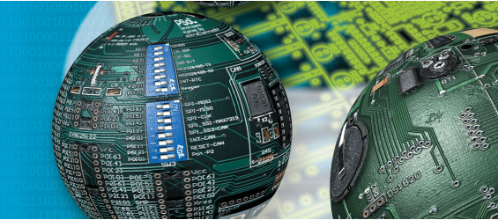
Embedded Systems I/O of TM4C123HG6PM
Fall 2018
NUCES – FAST

Slide 2
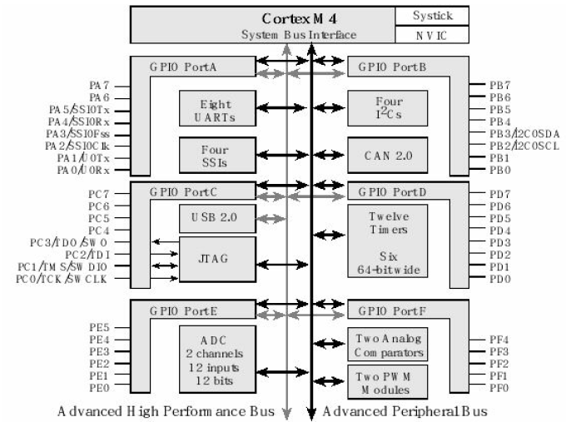

Slide 3
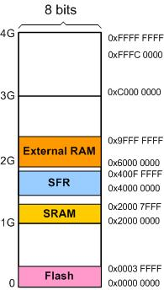
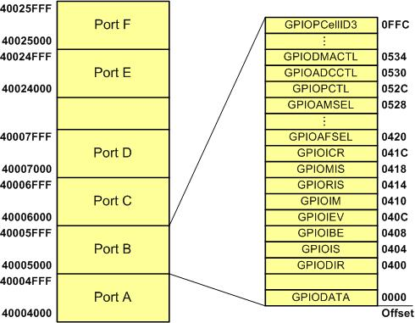
Memory Mapping (revisited)
Base address

Slide 4
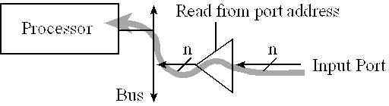
Basic Concept of I/O: Reading from Input Port
The LM4F/TM4C family of microcontrollers has 5V-tolerant digital inputs, meaning an input high signal can be any voltage from 2.0 to 5.0 V.

Slide 5
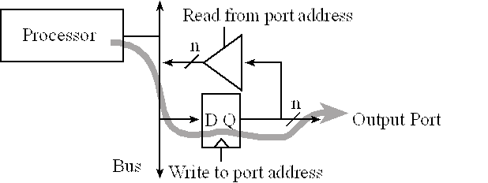
Basic Concept of I/O: Writing to Output Port
Readable Output port in TM4C: participate in both the read and write cycles very much like a regular memory
A write cycle to the port address will affect the values on the output pins. In particular, the microcontroller places information on the data bus and that information is clocked into the D flip-flops. Since it is a readable output, a read cycle access from the port address returns the current values existing on the port pins.

Slide 6
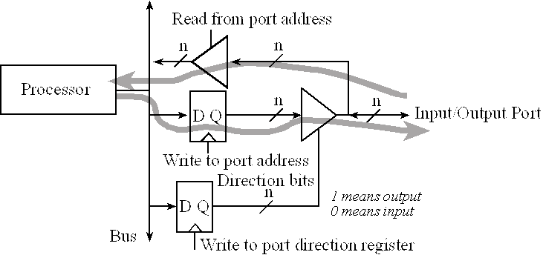
Configuring direction of port

Slide 7
Steps to initialize GPIO
Enable clock for the port and wait for its stabilizing
Unlock port (needed only for PD7 and PF0)
Disable analog function of the pin (by default disabled, so we can skip this step)
Clear PCTL register to select regular digital I/O (by default cleared, so we can skip this step)
Set direction of pin
Disable alternate function of port (by default disabled, so we can skip this step)
Enable changes to digital port
Enable digital function of the pins
Enable/disable Pullup resistor (depends on scenario)
Enabling clock should be the first step, rest of the steps can be in any order

Slide 8
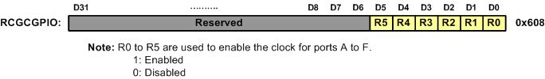
The GPIO Clock enable for all the I/O ports (RCGCGPIO (Run mode Clock Gating Control) Register )
Clock is enable for each port using SYSTCL_RCGCGPIO_R port
Clock is disabled to save power
Register is 32 bit wide
For enabling the clock we deals only with the last 8 bits.
After enabling, wait for stabilizing of clock by waiting for its respective status bit SYSCTL_PRGPIO_R to be true

Slide 9
LOCK register
After enabling clock, we have to unlock ports by writing a special value to LOCK register
GPIO_PORTx_LOCK_R = 0x4C4F434B

Slide 10
AMSEL register
Enable/disable Analog function of port by writing 1/0 to respective pins
Example:
GPIO_PORTF_AMSEL_R = 0x00;

Slide 11
PCTL register
For selecting regular digital I/O clear the bits
Example:
GPIO_PORTF_PCTL_R = 0x00000000;

Slide 12
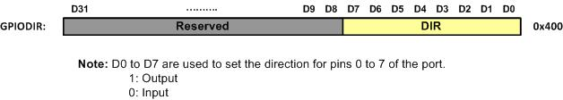
Direction Register (GPIODIR Register)
It is 8 bit wide register
Example:
GPIO_PORTF_DIR_R =0b00001101

Slide 13
Alternate Function register
To disable alternate function of port, clear the bits of AFSEL register
Example:
GPIO_PORTF_AFSEL_R = 0x00;

Slide 14
GPIO COMMIT register (CR)
By writing 1 to the respective bit field of this register allows us to make changes to the respective pins of the port.
GPIO_PORTx_CR_R

Slide 15
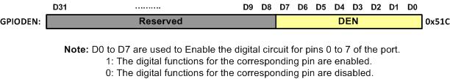
The GPIO Digital Enable Register: to use I/O pin as digital (GPIODEN Register)
Register Name:
GPIO_PORTx_DEN_R

Slide 16
PULL UP RESISTOR (PUR)
This microcontroller has in built pull-up resistor which are used when required
Pull up resistors are enabled by setting respective pin in GPIO_PORTx_PUR_R
Instead of using pull-up we are also allowed for using pull-down register by writing 1 to the PDR register instead of PUR.

Slide 17
Data Register (GPIODATA) in TI ARM (GPIOData Register)
Register Name:
GPIO_PORTx_DATA_R

Slide 18
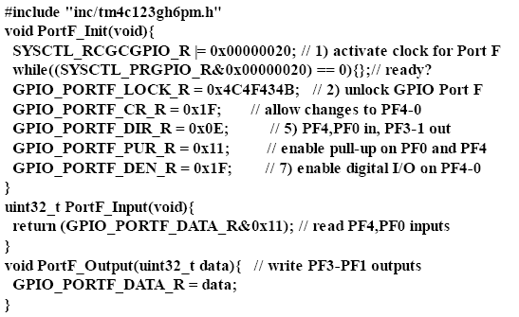
Example

Slide 19
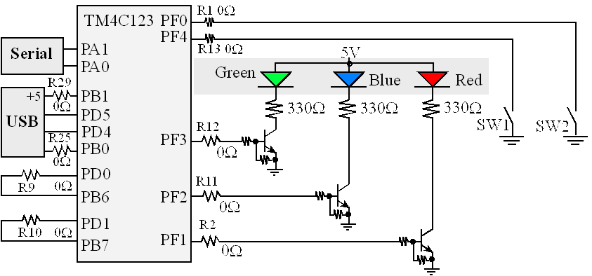
LEDs and switches on TIVA Launchpad

Slide 20
Exercise: Toggle Blue LED with SW1
#include <stdio.h>
#include "inc/tm4c123gh6pm.h"
#define SW1 (GPIO_PORTF_DATA_R&0x10)
void PortF_Init(void){
SYSCTL_RCGCGPIO_R |= 0x00000020; // activate clock for Port F
while((SYSCTL_PRGPIO_R&0x00000020) == 0){};// ready?
GPIO_PORTF_LOCK_R = 0x4C4F434B; // unlock GPIO Port F
GPIO_PORTF_CR_R = 0x14; // allow changes to PF2 & PF4
GPIO_PORTF_DIR_R = 0x04; // PF4 in, PF2 out
GPIO_PORTF_PUR_R = 0x10; // enable pull-up on PF4
GPIO_PORTF_DEN_R = 0x14; // enable digital I/O on PF2 & PF4}
void main(void)
{PortF_Init();
while(1){
if (!SW1)
GPIO_PORTF_DATA_R=GPIO_PORTF_DATA_R^0x04;
}
}

